Slide 1
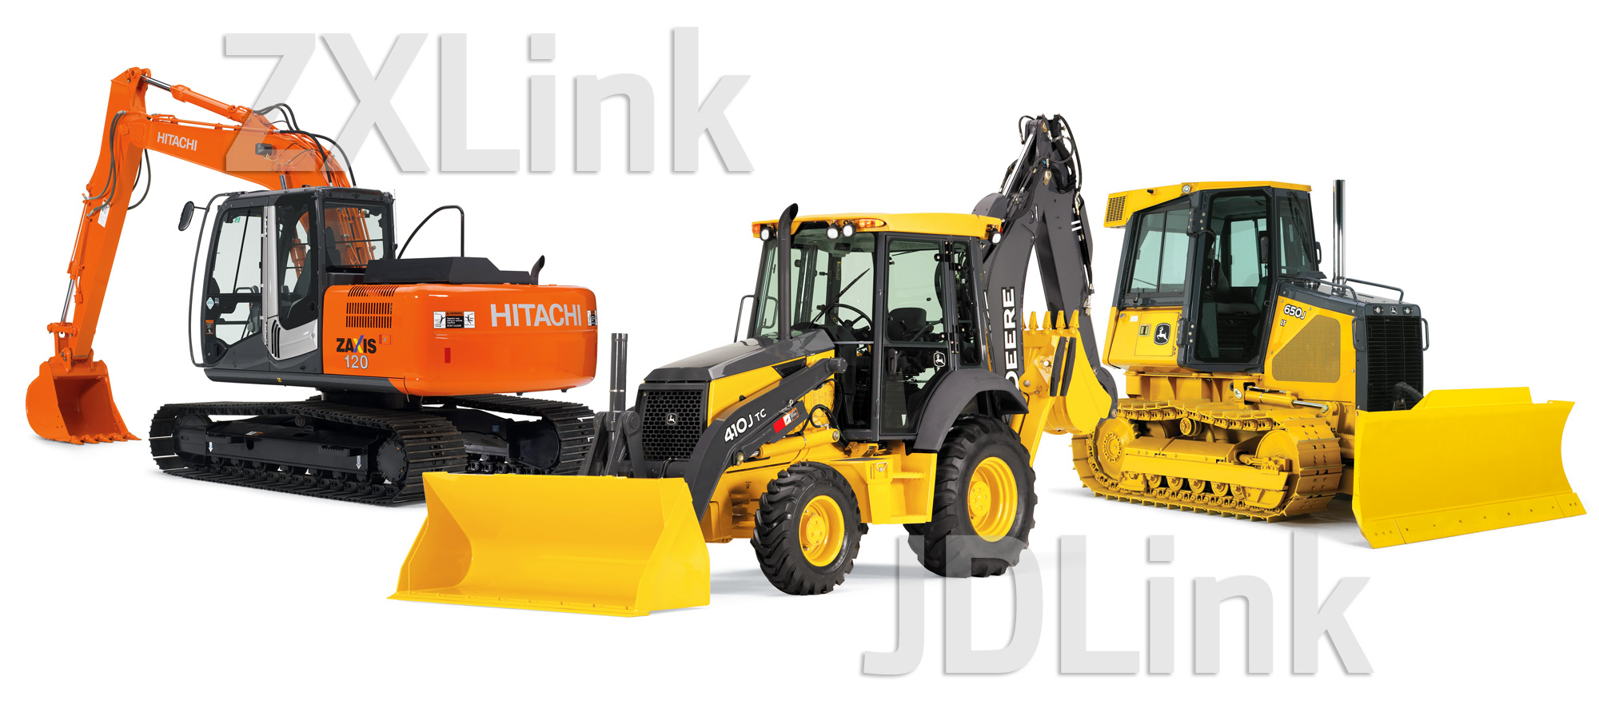
JDLink|ZXLink Technical Overview
Copyright © 2010 Deere & Company. THIS SOFTWARE OR DATA IS THE PROPERTY OF DEERE & COMPANY. ALL USE AND/OR REPRODUCTION NOT SPECIFICALLY
AUTHORIZED BY DEERE & COMPANY IS PROHIBITED. This product is for TRAINING PURPOSES ONLY. Do not use this material in place of the current revision of
Controlled documents such as technical manuals, operator's manuals or other work instructions. The information contained herein is confidential and proprietary to Deere &
Company and its affiliated entities. This information is being provided to authorized dealers or customers to assist in the marketing, sales, operation or repair of John Deere,
Timberjack or Hitachi branded products. No unauthorized disclosures may be made without the written permission of Deere & Company or one of its affiliated entities.
Notes:
Welcome to the JDLink and ZXLink Machine Monitoring System training program. This program will provide an overview of the John Deere JDLink system as well as the Hitachi ZXLink system.

Slide 2

In this course there are (2) lessons to complete.
Main Menu
Select a lesson or use the next arrow at the bottom of the screen to continue
Product Overview
Reference Material:
The course may refer to documents you can view and print. To access, click the "Attachments" button in the upper right corner.
Lesson 1 – Product Overview
Sales Overview
Lesson 2 – Technical Overview
Other Information
Audio/Notes:
This narrated presentation is best experienced with audio on. If your computer will not play the audio, click the "notes" tab to read the narrator's script.
Click here for navigation help
Help
Click here to go to the Post Assessment
Notes:
Click on one of the buttons to begin the Product Overview lesson or the Technical Overview lesson.

Slide 3
Product Overview
Product Overview
Describe JDLink/ZXLink
Identify the various hardware and subscription levels of JDLink/ZXLink
List the features of each level of JDLink/ZXLink
Explain the In Base Strategy for JDLink and ZXLink
Describe how the JDLink/ZXLink Machine Monitoring System works
Identify the major components
List the key features on the JDLink/ZXLink Web Application
Determine the relationship between JDLink/ZXLink and Fleet Care
Recall how JDLink/ZXLink enables Service Advisor Remote
Identify the value to the customer
Identify the value to the dealer
Notes:
In the Product Overview lesson, you will learn several things about the JDLink and ZXLink Machine Monitoring Systems. Listed on your screen is what you will learn in this lesson.

Slide 4
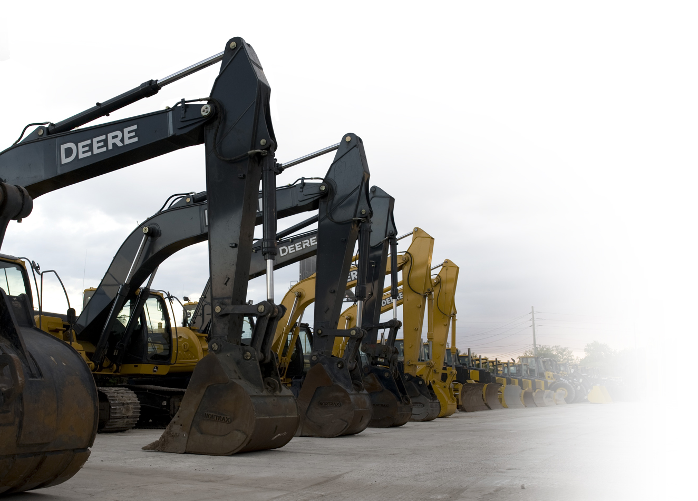
What is JDLink and ZXLink?
Telematics Fleet Management Solution
Remotely Monitor Machines
Hours
Location
Security
Utilization
Fuel consumption
Alerts and Diagnostic Trouble Codes
Notes:
JDLink is John Deere’s telematics fleet management solution. ZXLink is Hitachi’s telematics fleet management solution. So what is telematics? Telematics is simply the technology of sending, receiving and storing information via a telecommunications device. Using JDLink or ZXLink, customers and dealers can have an easy, manageable way to track hours, location and utilization of their fleet. The Geofence and Curfew security features can also assist with theft recovery or unauthorized use.

Slide 5
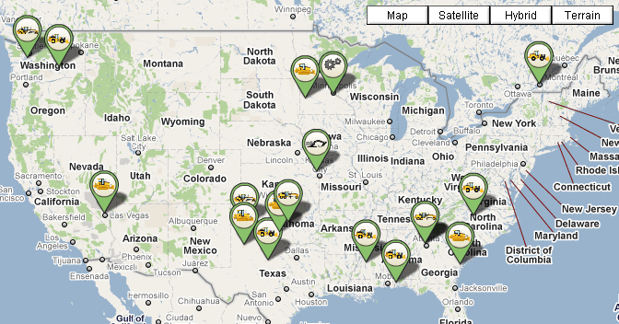
What can JDLink and ZXLink do?
Monitor your fleet from any location through the internet.
Notes:
JDLink and ZXLink allows users to monitor their fleet from any location through the internet. This is especially useful for large fleets that are dispersed in several worksites or across a large geographical area.

Slide 6
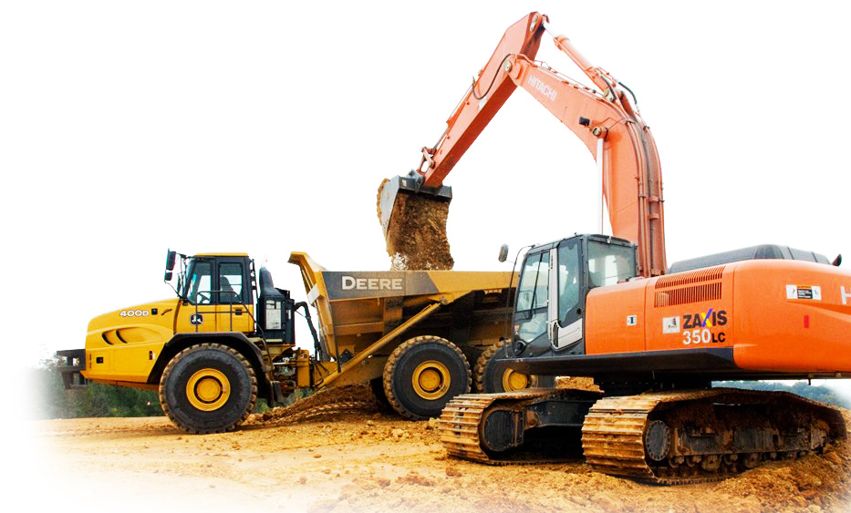
Hardware and Subscription Levels
Express
Select
Ultimate
Notes:
JDLink and ZXLink are available in three levels; Express, Select and Ultimate. We will discuss how each system works, the components that make it possible, and the features of each of these levels.

Slide 7
Levels of Service
Feature | Express | Select | Ultimate
Compatibility with all makes of machine with 12 or 24 volt system | ● | ●
Aerial view of machine locations | ● | ● | ●
Ability to create and maintain Geofences | ● | ● | ●
Machine Idle vs. Working tracking | ● | ● | ●
Maintenance Alerts | ● | ● | ●
Machine tracking, providing maps and driving directions to your machines | ● | ● | ●
Upgradeable to Ultimate |  | ● | n/a
Create custom alerts |  |  | ●
Diagnostic connection to local dealer |  |  | ●
Track machine's fuel usage and alert when low |  |  | ●
Operator and machine productivity comparison |  |  | ●
Machine specific feature utilization |  |  | ●
Notes:
JDLink and ZXLink are available in three subscription levels. Express and Select are compatible with all makes of machines and provide the same basic services, but use different hardware and have a different method for determining location. Express and Select differences will be covered in more detail later in this program. Ultimate is a John Deere or Hitachi machine specific offering and provides detailed machine information such as fuel consumption, work vs. idle and temperatures. Select and Ultimate use the same base hardware, so if Select is installed on certain John Deere or Hitachi machines, it can be upgraded to Ultimate.

Slide 8
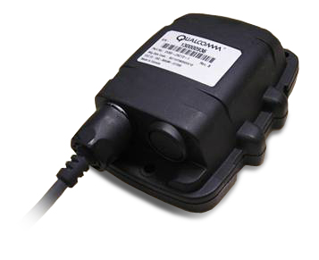
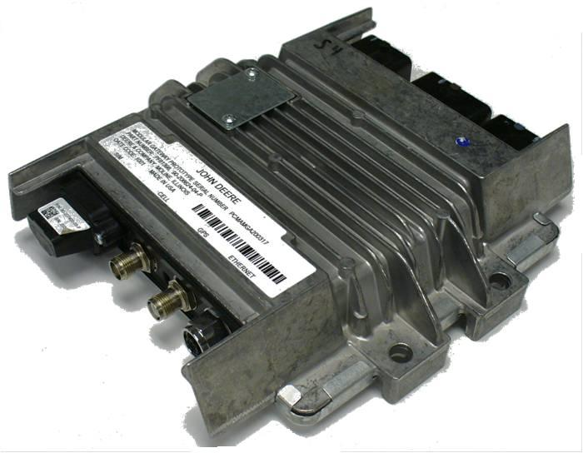
Express vs. Select Differences
Location
Select uses GPS to determine location
Express uses Assisted-GPS
Geofence
Express checks location once a day at scheduled call in time
Select checks location immediately when machine is running and once an hour when machine is off
Notes:
There are some key differences to understand between Express and Select. The first is how location is determined. Select (and Ultimate) have a stronger GPS chip and use only GPS to determine location. So it does not require a strong GPS signal to give an accurate location, but will have difficulty communicating location if it is indoors in many cases. Express uses what is known as Assisted-GPS. The assisted part of Assisted-GPS is only on the Express system. It has a weaker GPS chip and relies on nearby cell towers to help determine its location. The advantage of this is it can be possible to communicate location if the machine is operating indoors or in a restricted viewing area but has a good cellular signal. The negative is the more remote the machine is with weaker cell signals, location may not be able to be determined.
The other major difference between Express and Select is how it checks for a geofence breach. Express will only check its location once a day at its scheduled call in. If there is a curfew breach, Express will also check its location even if it is not during is scheduled call in time.
Select checks its location immediately when the machine is running and once an hour when the machine is off and the terminal is in sleep mode.

Slide 9
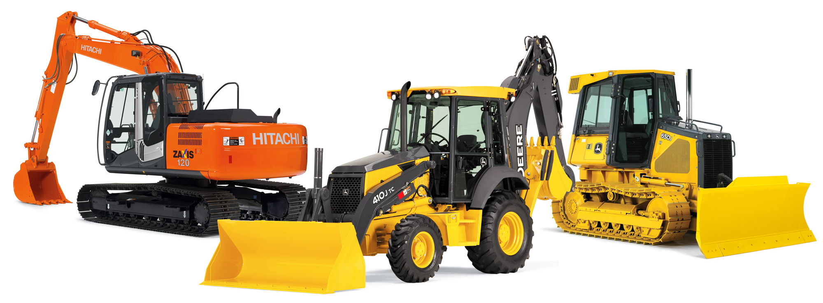
In Base Strategy
2010 there were 39 machines in base with Ultimate
27 John Deere machines
12 Hitachi machines
In 2011, that number will begin to more than double!
Machine Configurator or Info To Go will have the latest details
Notes:
Starting in January 2011, the in base strategy for JDLink and ZXLink will continue to expand. The machines with Ultimate in base will more than double early in 2011. For the latest list of machines that are part of the in base strategy, refer to the Machine Configurator on Dealer Net or Info To Go.

Slide 10
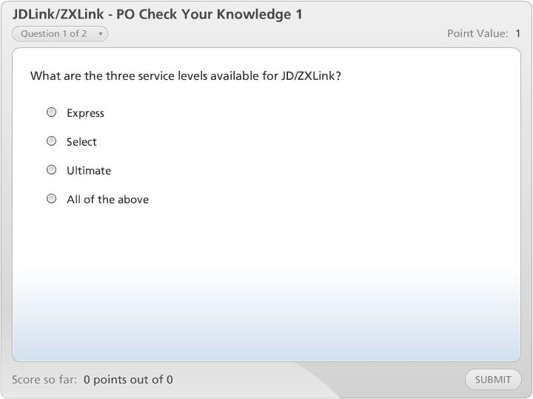



JDLink/ZXLink - PO Check Your Knowledge 1

Slide 11

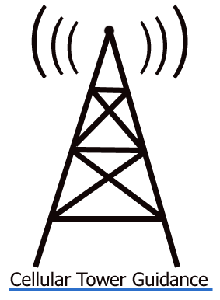
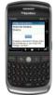



How Does JDLink Work? Select and Ultimate
GPS
Cellular
Recording
John Deere Data Server
Notes:
The Select and Ultimate hardware use GPS for determining its location and will record the machine operating data based on its service level. This information will be bundled and periodically sent over the GSM cellular network and to the John Deere Data Server. The data is then processed and made available on the JDLink or ZXLink website. The data will be transmitted by default once a day (usually during the night), but the customer can customize the frequency on the web in the Terminal Setup section. NOTE: If the customer uses the Geofence or Curfew features and there is a security breach, the system can be set up to communicate immediately. There are other customizable features that can be communicated immediately as well such as diagnostic trouble codes.

Slide 12
How does JDLink work? Optional Satellite Feature for Select and Ultimate (mid 2011)
GPS
Optional satellite communication
Recording
Note: Machines equipped with the optional satellite feature will still use cellular as the primary communication path and satellite will only be used when there is no cellular signal.
John Deere Data Server
Notes:
A new feature that will be made available later in 2011 is a satellite option. Details will be announced upon release. For customers that operate in areas that have limited cell coverage, the standard cellular based system will continue to record the data and send in the data when it receives a signal. For customers who need daily data delivery in remote locations, there is an optional satellite module available as a factory installed or field installed option. Machines equipped with the optional satellite feature will still use cellular as the primary communication path and satellite will only be used when there is no cellular signal. Also note, the data is bundled in a 24hr block rather than 30 minute granules and is only transmitted at a maximum once a day. All data will not available on the web when transmitted via satellite, but once a cellular signal is received, all the data will be updated.

Slide 13
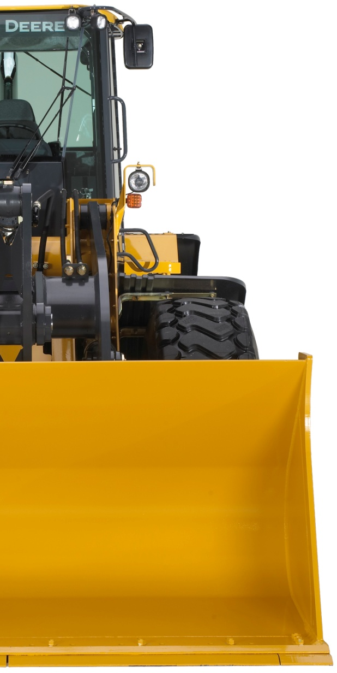
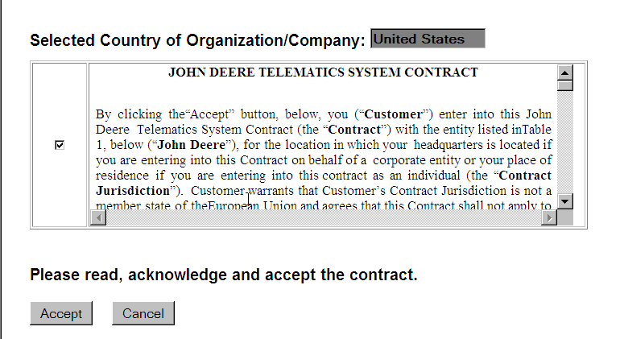
John Deere Telematics Contract
Notes:
Because all service levels use cellular technology to transmit information, they require not only the hardware but also cellular service which is arranged through acceptance of the Telematics System Contract. This contract is electronically accepted (similar to many other online services), and establishes the customers account so terminals can be transferred to the customer’s account and view them through the web application.

Slide 14
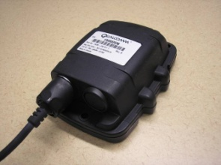

Express Components
JDLink Express Terminal
All Makes Solution
Power and Ground
Combines functionality of a cellular transmitter, data logger and antenna
Wired to the machine battery and alternator
Assisted-GPS (AGPS) for location
Possible to locate in buildings
Alternator
Connection
Express
JDLink Express Terminal
Notes:
Now we’ll cover the hardware that makes JDLink and ZXLink work. The Express level uses the Express Terminal. This terminal combines the functionality of a cellular transmitter and a data logger. The Express Terminal is wired to the machine battery for power and to the alternator to detect whether the engine is running or off.
This unit uses Assisted-GPS, to locate the machine by triangulating several cell tower signals and combining that with a GPS signal. This allows the unit to locate inside of buildings if it can not receive a GPS signal. NOTE: Not all cellular roaming partners have AGPS technology on their cell towers. Consult with your John Deere Technology Consultant for details in your area.
The Express Terminal is small enough to conceal under cab liners or other covers to allow for a “stealth” install which is difficult for potential equipment thieves to detect.

Slide 15
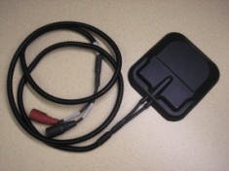
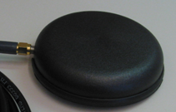
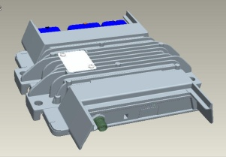
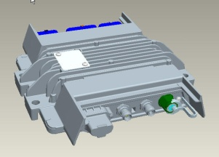

Select and Ultimate Components
Cellular Only Solution
Satellite Module Solution
Cellular/GPS Antenna
Power and Ground
Satellite Antenna
Vehicle CAN
Connection
Sensor
Wiring
Alternator
Connection
Modular Telematics Gateway (MTG)
Notes:
Select and Ultimate both use the Modular Telematics Gateway (MTG). The MTG combines the functionality of a cellular transmitter and a data logger. It collects engine run hours and location. If the machine has the Ultimate subscription level, it collects machine data off the CAN. All of the data collected for both Select and Ultimate is transmitted to Deere Data Services via the cellular network connection.

Slide 16

Select and Ultimate Components
Cellular Only Solution
Satellite Module Solution
Cellular/GPS Antenna
Power and Ground
Satellite Antenna
Vehicle CAN
Connection
Sensor
Wiring
Alternator
Connection
Low Profile Antenna
GPS receiver for location
Cellular antenna for data transmission
Transmits through plastic, glass or fiberglass
Notes:
16
A low profile antenna combines both a GPS receiver for location as well as a cellular antenna for data transmission. The low profile antenna is small enough to conceal under cab liners or other covers. It can transmit through plastic, glass or fiberglass allowing for a “stealth” install which is difficult for potential equipment thieves to detect. This unit uses the GPS antenna to receive signals to locate the machine with multiple satellites for increased accuracy. The antenna must have a clear view of the sky to use the GPS location function. NOTE: Field installed antennas should be protected from direct spray from pressure washers, so consider this when determining the antennae's mounting location.

Slide 17

Select and Ultimate Components
Cellular Only Solution
Satellite Module Solution
Cellular/GPS Antenna
Power and Ground
Satellite Antenna
Vehicle CAN
Connection
Sensor
Wiring
Alternator
Connection
Optional Satellite Module
Available later in 2011
Provides Satellite data transmission
Cellular is always primary communication
Notes:
17
Available later in 2011 is the optional satellite module. It provides satellite data transmission for customers operating in remote locations for extended periods of time. It is not a stand alone option and cellular is always the primary method of communication with satellite as the back up communication method. It is important to note that satellite will not transmit all machine data. As soon as the machine gets a good cellular signal, it will transmit all data.

Slide 18
Select and Ultimate Components
Cellular Only Solution
Satellite Module Solution
Cellular/GPS Antenna
Power and Ground
Satellite Antenna
Vehicle CAN
Connection
Sensor
Wiring
Alternator
Connection
Satellite Module Antenna
Conceals under cab liners or other covers
Transmits through plastic, glass or fiberglass
Notes:
18
The optional satellite feature uses an additional antennae that is installed on the machine.

Slide 19
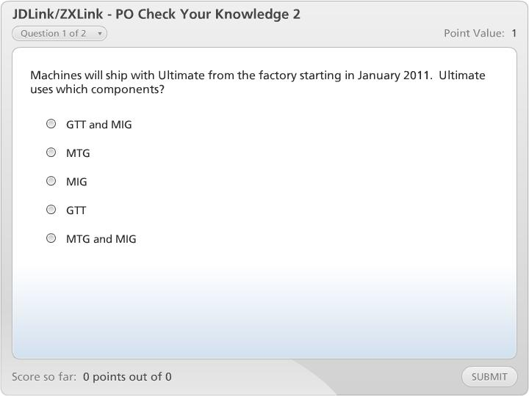
JDLink/ZXLink - PO Check Your Knowledge 2

Slide 20
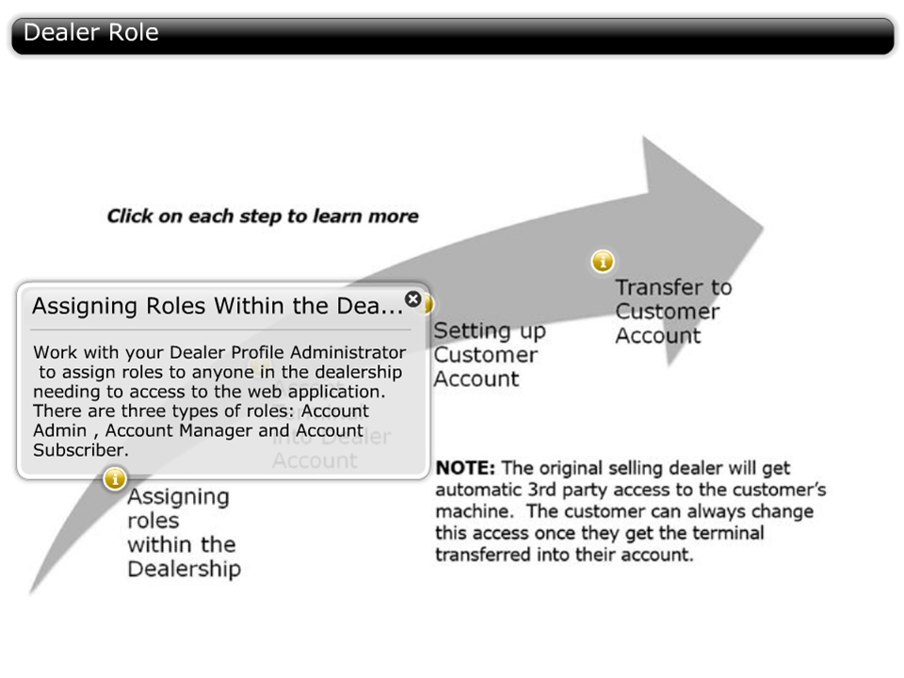

Dealer Role
Notes:
When a factory-installed JDLink or ZXLink system is delivered to your dealership, or a customer has purchased a field-installed kit, there are many steps that must be taken at the Dealership to ensure a successful transfer to the customer.

Slide 21
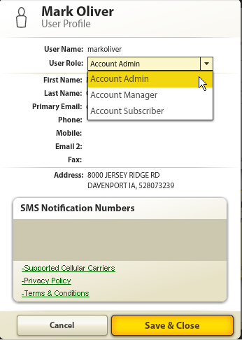
Web Application User Roles
JD/ZXLink Web Application
Account Admin
Account Manager
Account Subscriber
Notes:
Before we review the basics of the web application, it is important to understand the user roles. There are three levels of users within the JDLink/ZXLink website: “Account Admin”, “Account Manager” and “Account Subscriber.” The “Admin” at a Dealership organization can define these roles for dealer employees. When setting up a customer’s account for the first time, dealers must designate an Admin for the customer’s account. The customer admin can then assign users within their organization and designate what type of access they can have when logged into the web.

Slide 22
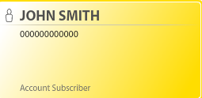
Web Application – User Roles
Account Subscriber
View Dashboard
View Landmarks
Driving Directions
View Alert Escalation Preferences
View Geofences and Curfews
View Terminal Preferences
View Equipment Groups and User Groups
Call or “Ping” Machines
Notes:
Listed on the screen are some of the functions that an Account Subscriber or general user can perform within the web application. The general rule is an account subscriber has “view only” access and can not make any changes.

Slide 23
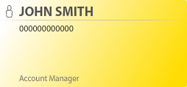
Web Application – User Roles
Account Manager
Performs all Subscriber roles with the addition of:
Create, Update and Delete Landmarks and Landmark Categories
Create, Update and Delete Equipment Groups
Create, Update and Delete Geofences and Curfews
Update Terminal Settings
Create, Update and Delete Alert Preferences
Update Organizational Preferences
Notes:
Account Managers have all the rights of an account subscriber, but also has the ability to create, update and delete parameters. Listed on the screen are just a few of the manager features.

Slide 24
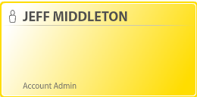
Web Application – User Roles
Account Administrator
All Account Manager roles with the addition of:
Create, Update and Delete User Groups
Grant 3rd Party Access
Transfer Terminals
Notes:
The account administrator has full access to the features within the web. The key additional functions that the Account Admin performs are controlling the users and their access levels, granting 3rd party access and transferring terminals.

Slide 25
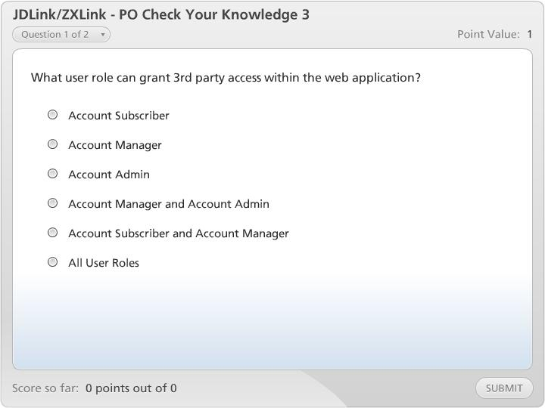
JDLink/ZXLink - PO Check Your Knowledge 3

Slide 26
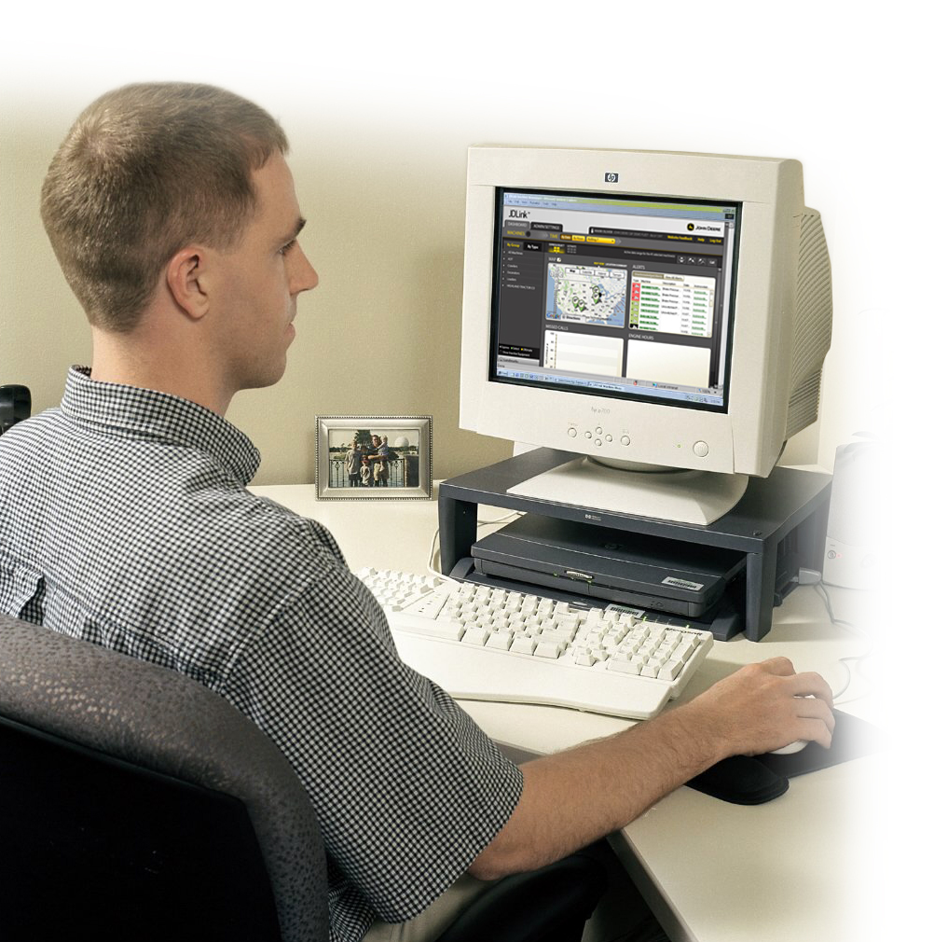
JDLink/ZXLink Web Application
Web is available in four “Theme” styles*
Green for A&T and Forestry Customers/Dealers
Yellow for Construction Customers/Dealers
Orange for Hitachi Customers/Dealers
Gray for a Generic theme
* Available on the Company Preferences Tab
Notes:
Because our customer base using the JDLink or ZXLink web application covers Ag and Turf, Forestry, Construction, Hitachi and mixed fleet customers, the web is available in four display themes. Each account Administrator can choose their preferred theme style on the Company Preferences tab when they log in for the first time.
During the brief web overview on the following slides, we will use the generic display theme.

Slide 27
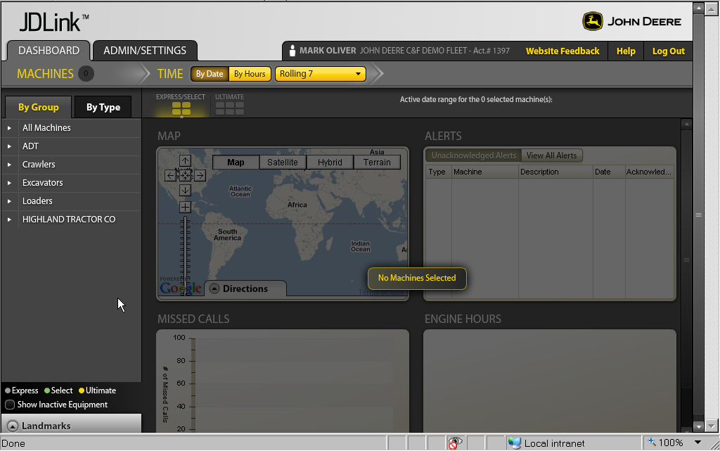
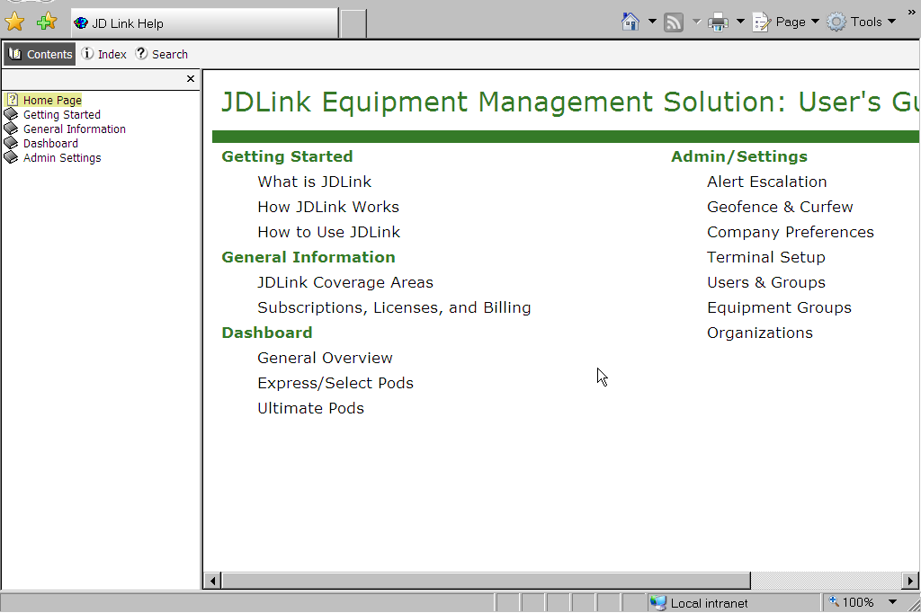
Opening Dashboard
Notes:
We will now take a brief tour of the new JDLink/ZXLink web application. There will be DLC and Webinar opportunities for detailed web application training. See JDU or Info To Go for details.
Once logged into the web application, your opening view will be the main dashboard. No machines will be loaded until a machine group is selected to the left. The first time a customer or dealer logs in, all machines will be listed in the “All Machines” category.
To view a machine or machine group, click on your desired machine or group from the left side.
If a user has questions about how to navigate the web application, the link “HELP” is always a great starting point. The user would simply click on any of the topics to learn more.

Slide 28
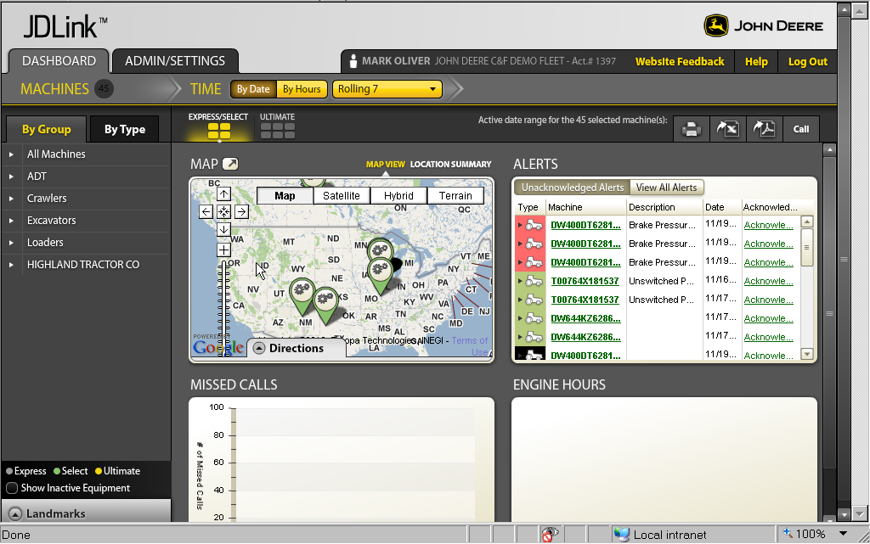
Dashboard with Machine Group Loaded
Notes:
Now that a machine group is selected, the map pane, alerts pane, missed calls pane and the engine hours pane will populate. Notice that the cursor is hovering above the map pane and there are the options of map view or location summary view. Every window pane in the web application will have multiple viewing options available to the user.
We will now move to the landmark feature which is located on the lower left.

Slide 29
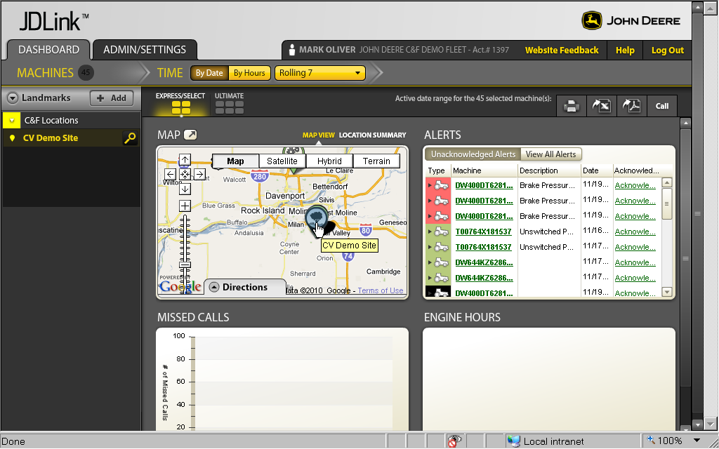
Landmarks
Notes:
The landmark feature allows the user to create custom points of reference. For dealers, it is recommended that they load all of their store locations on initial log in. Simply hit the ADD button to create a new landmark and follow the instructions.
We will now move to the Admin/Settings tab which is located on the upper right.

Slide 30
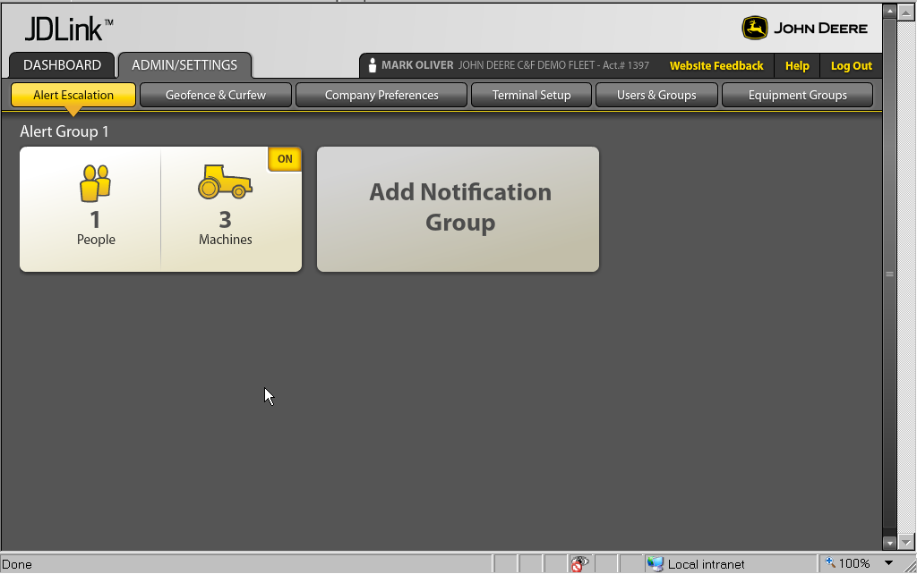
Alert Escalation
Notes:
Alert Escalation is the first tab that comes into view. This is where customers and dealers can set up the contacts for various levels of alerts such as geofence and curfew breach alerts.

Slide 31
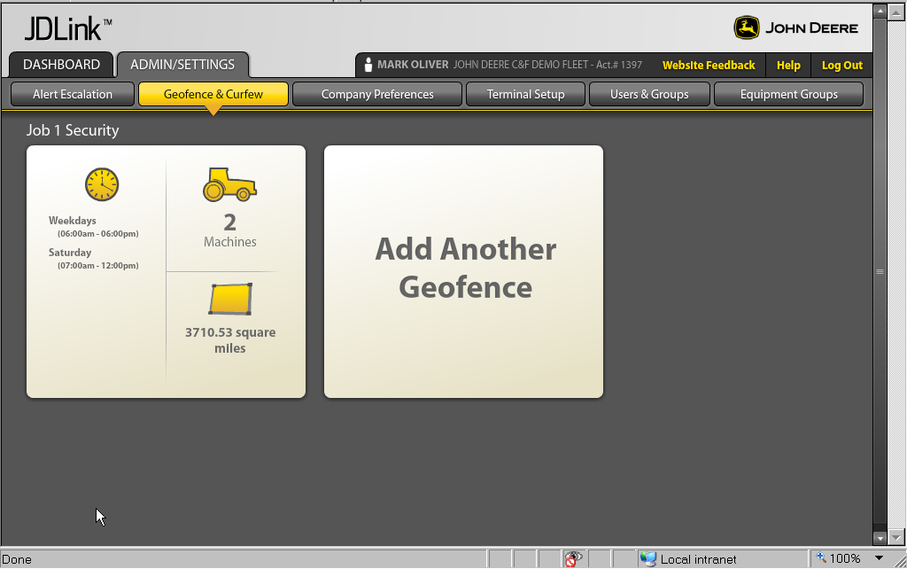
Geofence and Curfew
Notes:
The Geofence and Curfew tab allows to define, turn on and turn off the security features available within the web application.

Slide 32
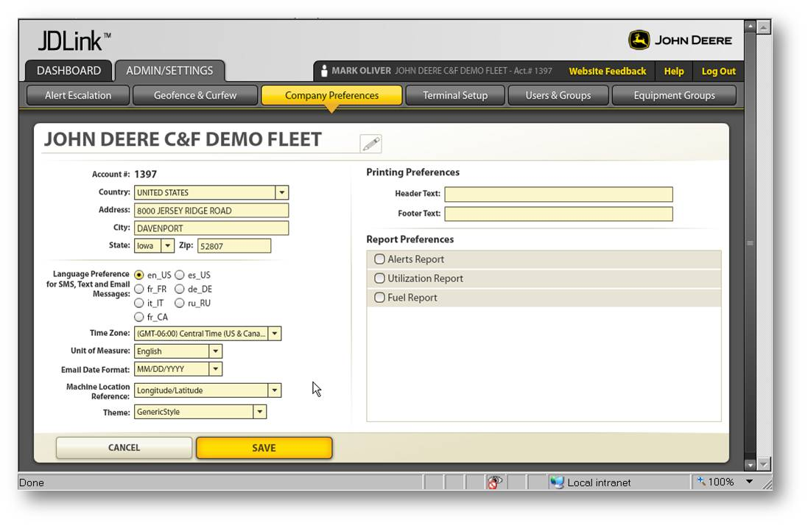
Company Preferences
Notes:
The Company Preferences tab is where the Account Administrator can define items such as language, unit of measure, date format, web theme and automated report preferences.

Slide 33
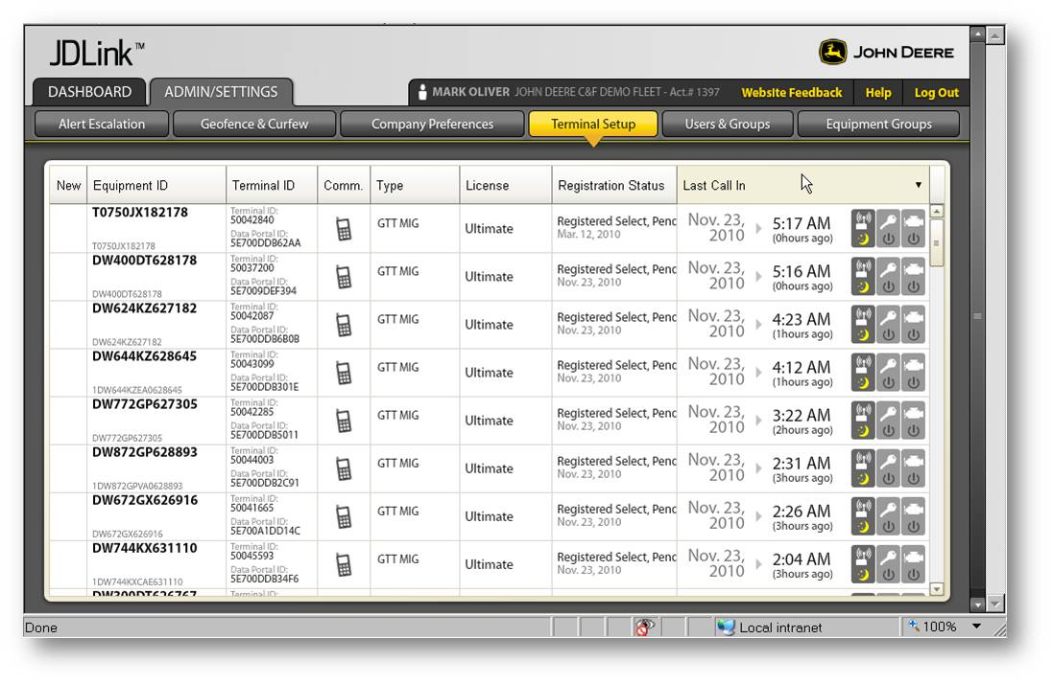
Terminal Setup
Notes:
The Terminal Setup tab is where details of each terminal is located. The user can accept terminals into their fleet, setup call in frequency, assign an asset name and transfer terminal out of their account when sold. NOTE: Many of these features are only available to the Account Admin.

Slide 34
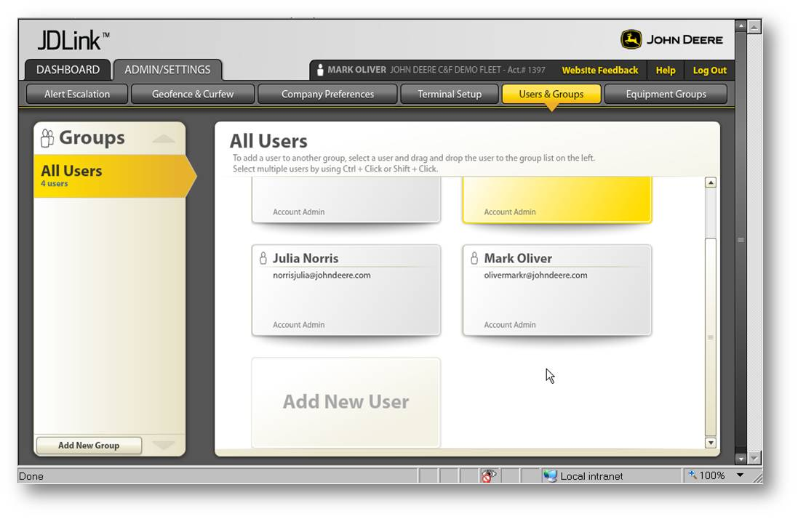
Users and Groups
Notes:
The Users and Groups tab is where Account Admin can assign users access levels as well as add new users. This is a “Click and Drag” feature when assigning visibility to additional groups on the left side.

Slide 35
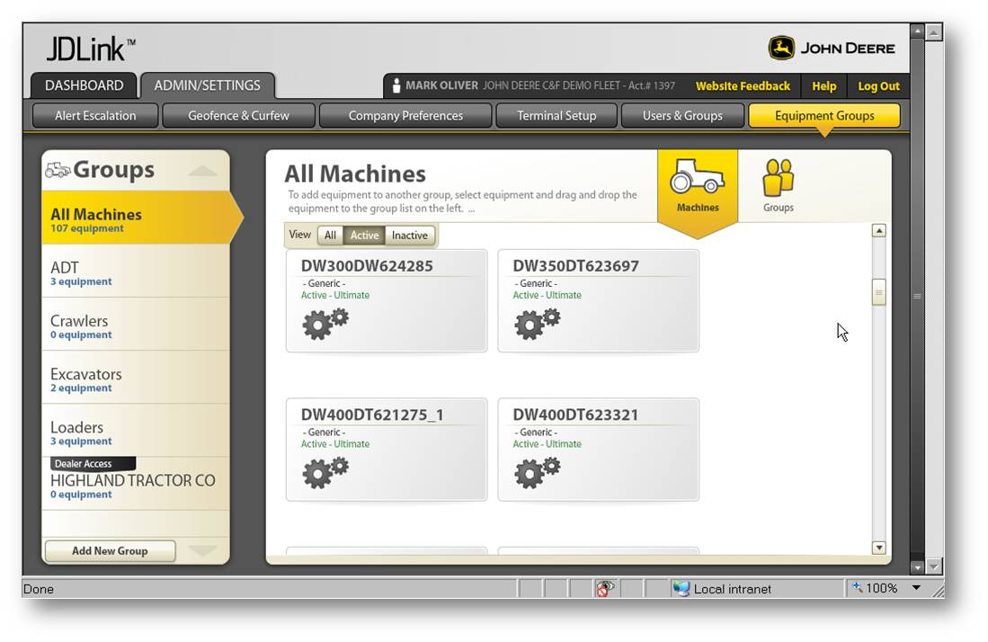
Equipment Groups
Notes:
The Equipment Groups tab is where the customer can assign machines to specific groups such as job locations. Again, this is a simple “Click and Drag” feature. By clicking “Add New Group” on the lower left, the Account Admin or Manager can create new groups for their organization or create a Dealer Access Group so other dealers besides their selling dealer can view their machines.

Slide 36
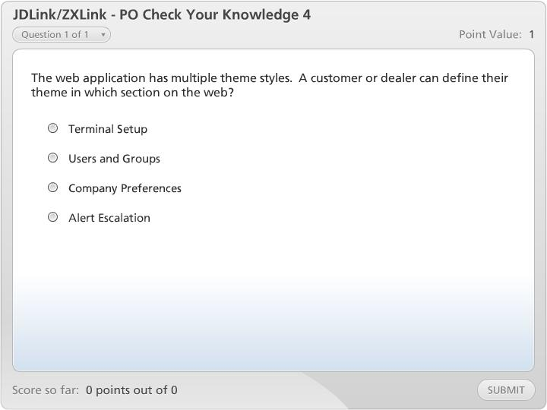
JDLink/ZXLink - PO Check Your Knowledge 4

Slide 37

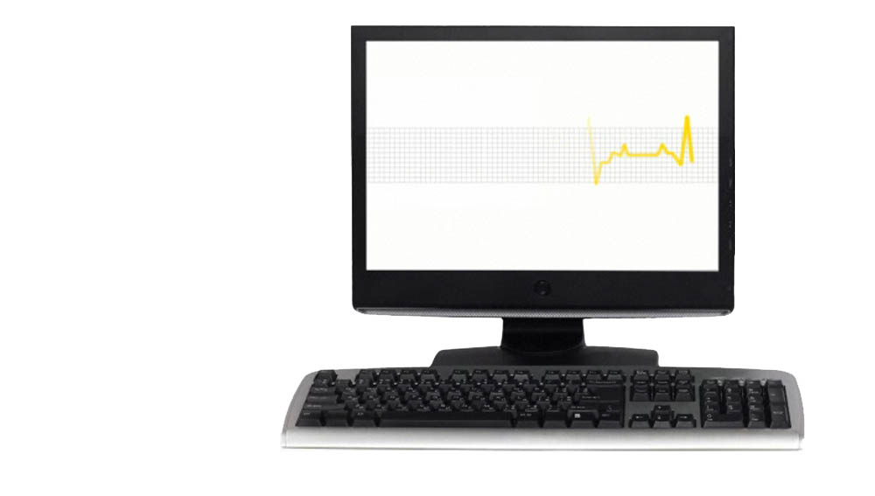
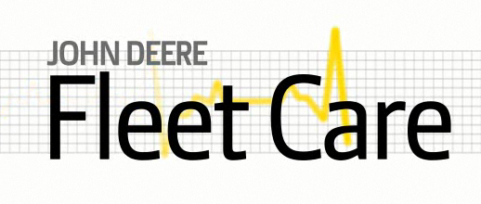
Fleet Care
JDLink/ZXLink
Fluid Analysis
PM Services
Machine Inspections
Business Rules
Delivers machine health solutions for the customer-via work order or email.
Notes:
By now, you have probably heard about John Deere Fleet Care and how it will change the way customers view machine health. Fleet Care provides customers and dealers the ability to have machine health be a proactive process rather than a reactive process.
JDLink or ZXLink is a key input to making Fleet Care work efficiently. Fleet Care takes data from the four sources shown on your screen and pushes it through a set of Deere proprietary, industry exclusive business rules and integrates these machine health solutions into your business system.
NOTE: JDLink or ZXLink is not required to make Fleet Care function, but it does automatically provide critical information such as hours and diagnostic trouble codes to make the Fleet Care system more efficient.
37

Slide 38
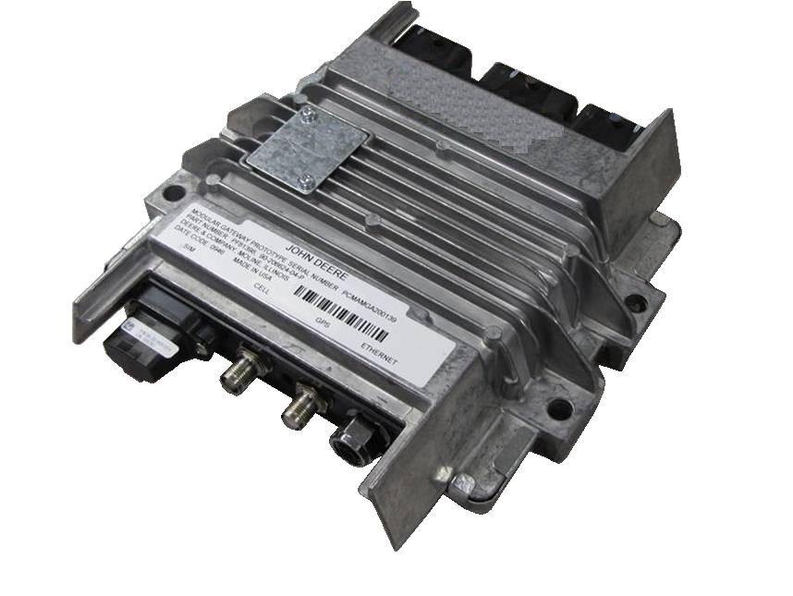
JDLink and Service ADVISOR Remote
To establish a remote connection:
Machines need to be equipped with a JDLink™ Modular Telematics Gateway controller (MTG).
Machine must have a current JDLink™ Select or JDLink™ Ultimate subscription.
+
JDLink ZXLink
MTG Controller
(Modular Telematics Gateway )
Note: To be field installed on a machine, the machine must also be JDLink™ Ultimate compatible and approved for Service ADVISOR™ Remote.
Notes:
Service ADVISOR Remote will be a new feature that will launch in conjunction with the new JDLink/ZXLink hardware. In order for a technician to establish a remote connection to a machine using the Service ADVISOR™ Remote feature, the machine must first be properly equipped. Machines must be JD/ZXLink Ultimate capable and need to be equipped with a JDLink™ Modular Telematics Gateway controller. In addition to this controller being installed on the machine, the machine must also have a current JDLink™ Select or JDLink™ Ultimate subscription.
For complete details of the Service ADVISOR Remote functionality and connection features, refer to the Service ADVISOR Remote DLM available in John Deere University.

Slide 39
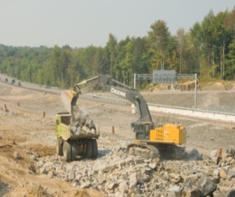

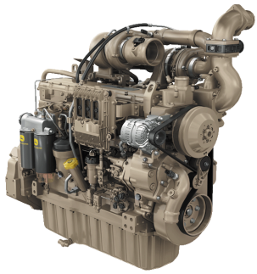


JDLink and Service ADVISOR Remote
The MTG controller:
JDLink and ZXLink Ultimate In Base Strategy will be expanding in 2011
In base machines will have 3 years of Ultimate service included
Can be added as a field installed option to machines approved for JDLink™ Ultimate.
Important: Dealers have access to all machines, however, customers can limit which dealers have access through the Terminal Setup screen in the JD/ZXLink web application
Notes:
With the in base strategy expanding significantly in 2011, most models built starting in January2011 will be equipped with a Modular Telematics Gateway (MTG) controller with 3 years of service included. The MTG controller can also be added as a field installed option to machines approved for JDLink™ Ultimate. By default, dealers will have access to all machines, but the customer can choose to limit dealers access in the JD/ZXLink web application on the Terminal Setup page.

Slide 40
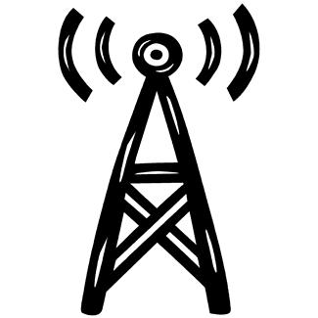
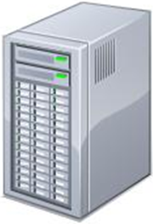
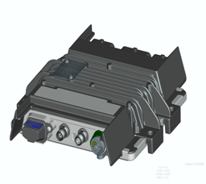


How Service ADVISOR™ Remote Works
CommServices Server
Relays message via cellular to MTG controller on machine.
JDLink MTG
Server
Authenticates User
Queues request
Assigns ID number
INTERNET
INTERNET
Email Request Received
Note: The default is to send the email but user can choose not to receive an email.
Notes:
So how does JDLink enable Service ADVISOR Remote to work? Using Service ADVISOR™ Remote, the user submits a request through the internet to the John Deere Custom Performance server which authenticates the user, queues the request and assigns an identification number.
The request is then sent to the CommServices server which relays the message via the cellular phone network to the Modular Telematics Gateway controller located on the customer’s machine.
An email is then sent to the technician with the identification number that the request has been received on the machine.

Slide 41

How Service ADVISOR™ Remote Works
Machine must be in range of cell service.
The Modular Telematics Gateway (MTG) controller is connected to the CAN Bus on the machine
CommServices Server
JDLink MTG
Server
INTERNET
INTERNET
Transaction queued for next months billing.
Email Request Completed
Note: charges are accumulated and dealer is billed monthly.
Notes:
The Modular Telematics Gateway controller is connected to the CAN Bus on the machine and requests the desired information from the machine’s individual controllers. The individual controllers then provide the requested information back to the Modular Telematics Gateway controller.
Once the Modular Telematics Gateway controller receives all of the requested information, it sends the information back to the Communication Services Server through the cellular network. This information is then sent to the John Deere Custom Performance Server where it is stored for up to one year. At this point the server again sends an e-mail message to the user notifying them that the request has been completed and is available for viewing. At this point the dealership is billed for the request.

Slide 42
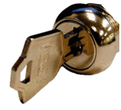
How Service ADVISOR™ Remote Works
If machine is out of range of cell service
CommServices Server
or
JDLink MTG
Server
Request will sit on the CommServices server for a period of time.
Key switch is in the off position.
INTERNET
INTERNET
Request
Notes:
If the key switch is in the off position, or if the machine is out of range from cell service, the request will sit on the CommServices server for a period of time set by the requester. The CommServices server will periodically attempt to send the message out to the machines Modular Telematics Gateway controller until conditions are met for this to occur.
If the machine is equipped with the optional satellite feature that will be available later in 2011, SAR will not connect via satellite if the machine is out of cellular service.
It is key to understand that if SAR cannot connect to a machine, a technician must know the basic troubleshooting process of the JD/ZXLink system. As an example, if the MTG is hibernating (by default, key off for 7 days but this can be modified), SAR will not connect. The technical overview will be a good resource for understanding the basics of JD/ZXLink troubleshooting.

Slide 43
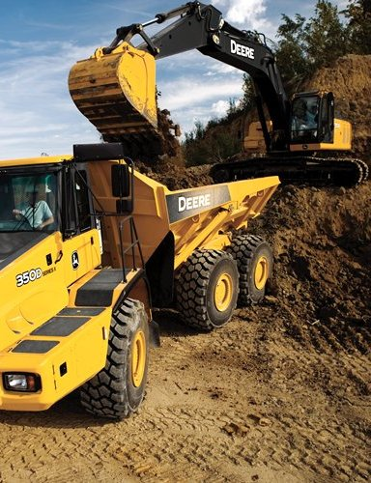
Customer Value
Track fleets in multiple locations
Maximize equipment utilization
Monitor machine health and performance
Enhance machine security
Increase machine resale value
Increase accuracy of job costing
Improve future bidding
Enhance maintenance scheduling
Opportunity to promote Fleet Care
Notes:
With the release of the new hardware and the expansion of the in-base strategy, what is the value to your customer? JDLink and ZXLink provide accurate and up to date information to your customers automatically to help them better manage their fleet. The result is the list of benefits shown on your screen.
By providing greater visibility to their machine utilization, customers can accurately track actual machine costs on a job allowing for more efficient billing and for more accurate bidding on future jobs. JDLink and ZXLink also provide you with the opportunity to promote Fleet Care to help customers with their maintenance scheduling as well as increase the overall health of their fleet.

Slide 44
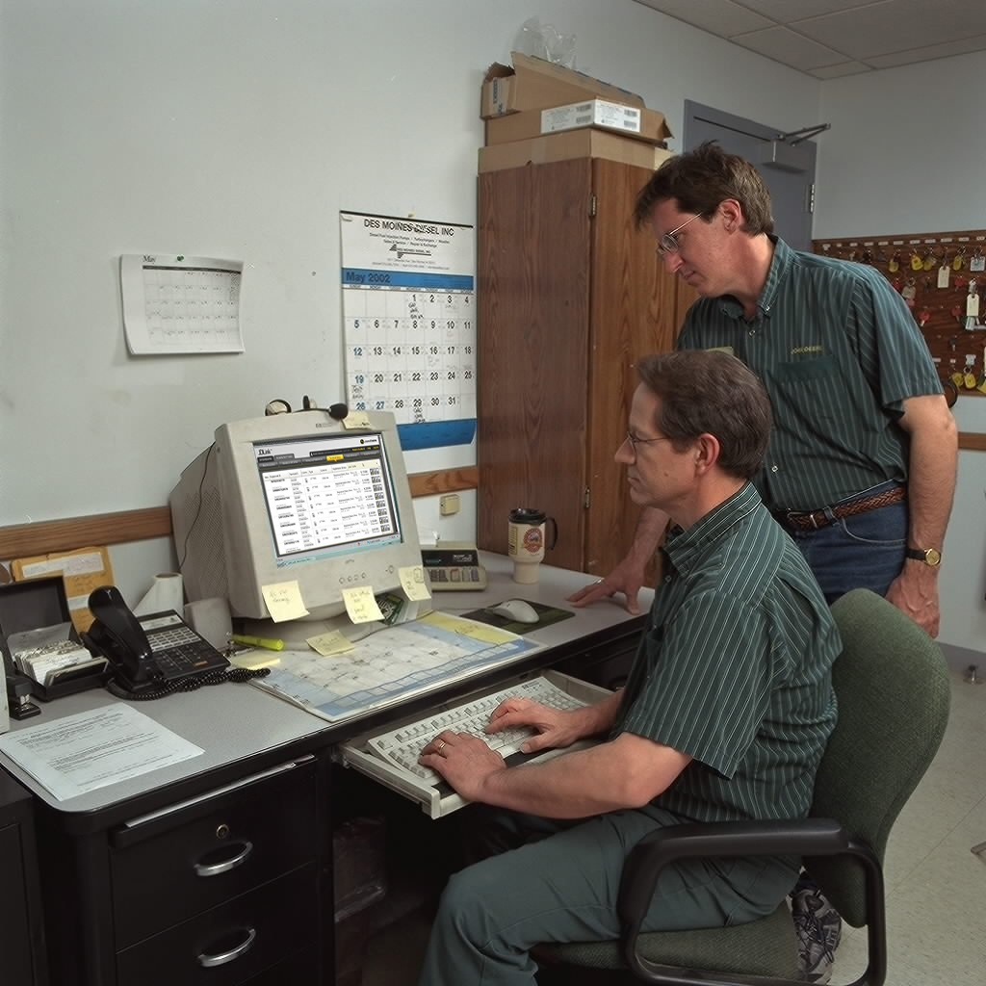
Dealer Value
Help sell more profitable PM agreements
Promote the benefits of Fleet Care
Minimize wasted drive time
Coordinate field service during equipment down time
Build stronger relationship with customers
Increase rental return
Opportunity to recommend machines based on utilization data
3rd party visibility to your customer machines
Enables ServiceAdvisor Remote
Notes:
JDLink is also a valuable tool for dealers. The days of making frequent calls to the customer to get accurate machine hours and location, or having a technician driving from job site to job site trying to locate equipment, is a thing of the past. When a dealer has 3rd party visibility to their customer’s machines and the ability to use Service Advisor remote, dealers can help customers minimize unscheduled downtime. All of this to help build a stronger relationship with your customers.

Slide 45
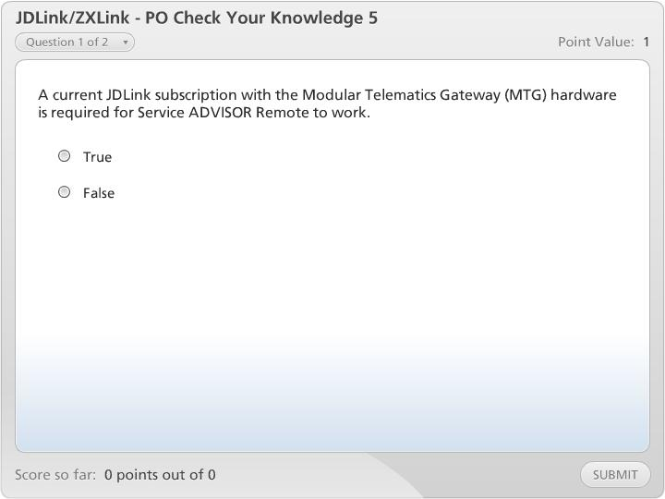
JDLink/ZXLink - PO Check Your Knowledge 5

Slide 46

3rd Party Software Integration
Automatically populates JDLink information into customer’s business system
One point of access for dealer/customer fleet management needs
Reduces manual data entry
Increases accuracy and timeliness of data transfer
John Deere will also follow the AEMP telematics standard
Notes:
3rd party software integration can be a valuable tool for dealers and customers. For details on how to integrate JDLink and ZXLink data into your customers business system, contact your local John Deere Technology consultant. Having the data available automatically in your business system minimizes the need of logging into the web everyday to get basic information such as hours and location.
For customers that have mixed fleets with multiple telematics systems, John Deere will follow the AEMP telematics standards to simplify integration of certain data points into their business system.

Slide 47

Integrated Software Packages
JDIS
PFW
RentalMan
HCSS
JDEdwards
NDS
And many more
Notes:
There are many software packages that JDLink and ZXLink data can be integrated into. Contact your local John Deere Technology Consultant if you have any questions related to data integration.

Slide 48

AEMP Telematics Standard
Telematics Data Standard
Developed by the Association of Equipment Management Professionals (AEMP)
Comprised of large fleet owners and governmental agencies
Provides data regarding location, usage, and fuel consumption
Subset of JDLink data
Intended to provide data accessed from multiple providers
Allows the customer to obtain this data from multiple providers
Available for use in customer operational and business reporting
Notes:
So what is AEMP? AEMP is the Association of Equipment Management Professionals. Working with four of the major construction equipment manufacturers, including John Deere, a standard was created for certain telematics data points so customers can easily integrate those data points into their business system if they run mixed fleets.

Slide 49
Telematics Standard Data Elements
Element | Description
Current hour meter readings | Current hours on the machine
Total Fuel Consumption* | Fuel consumed to date, over the life of the machine
Last 24 hr Fuel Consumed* | Fuel consumed over the last 24 hours
Current Location (GPS) | Longitude and latitude of current location
Odometer | Cumulative miles/kilometers traveled (when appropriate)
* Only 1 of the 2 fuel consumed data points will be supplied by each data provider
List shows all of the data elements within the AEMP Telematics Standard
John Deere will provide the data elements in darker text
Notes:
These are the five data elements that the manufacturers agreed upon to make available in the same format to make integration easier for mixed fleet customers. The darker text are the data points that John Deere will provide in the agreed format. For the latest information on AEMP, contact your John Deere Technology Consultant or Info To Go.

Slide 50
What Does This Mean for Your Customer?
Data elements can be retrieved at a scheduled interval
Provides data in a more timely solution than manual retrieval
Data can be pulled as often as once per hour
Eliminates the need to go to multiple websites to view information and manually key data into the customer database
Data can be used in customer business system
Assists in asset management
Information used for work order generation
Machine maintenance planning and history
Data can be used to create reports
Usage reports
Owning & operating costs
Notes:
So what does this mean for you and your customer? For dealers, this helps eliminate potential barriers of the customer wanting to run only one telematics solution. For customers, it minimizes the need to go to multiple websites on a daily basis to get the standard data points they need to run their business such as hours and location. The web is still there to access when more in depth detail is required such as diagnostic trouble codes, temperatures, etc.

Slide 51
Support Available
Help Files on the Web
Located on the top right of the opening dashboard
JDU Training
DLM’s and DLC’s will be posted peridically
Info To Go
Contains quick reference info and other training tools
Customer Contact Center (CCC)
Used for general account and subscription support
Dealer Technical Assistance Center (DTAC)
Any technical related issues for the machine or JD/ZXLink
Dealer Marketing Assistance Center (DMAC)
Kit compatibility and ordering information
Notes:
There are numerous places to get support for JDLink and ZXLink. Listed on the screen are a few sources at your disposal. Remember, the Help files link is always a good starting point if the user has questions in regards to web navigation.

Slide 52
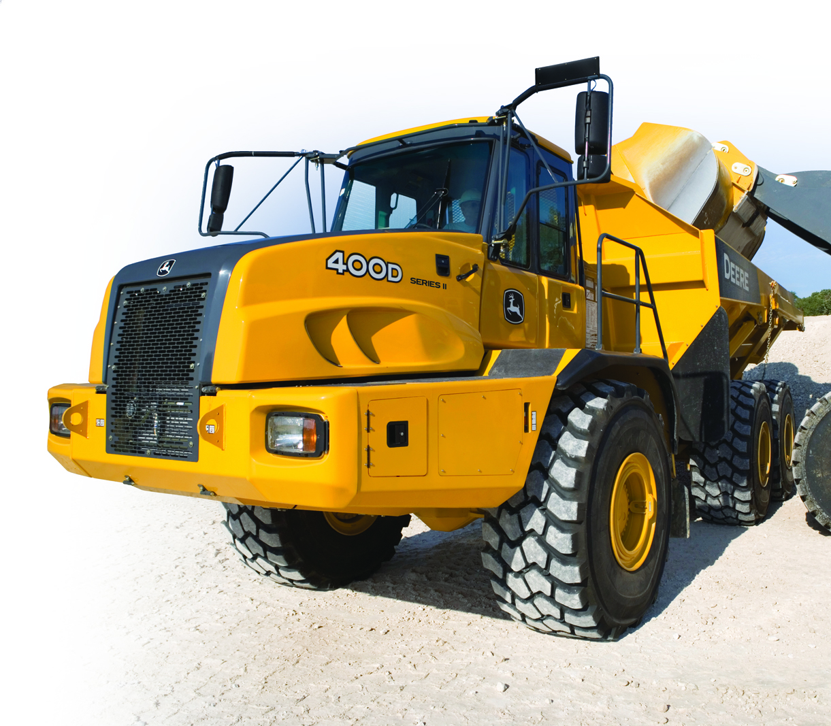
JDLink and ZXLink Differentiation
Qualified Dealer network
Factory support through the CCC (Customer Call Center) and DTAC (Dealer Technical Assistance Center)
Data accessed in one location
Business system integration
All-makes solutions
Factory or Field installation
In Base machines come with 3 years of service
Factory optional installs or field installs come with 1 year of service
Notes:
Listed on your screen are the JDLink differentiators.

Slide 53
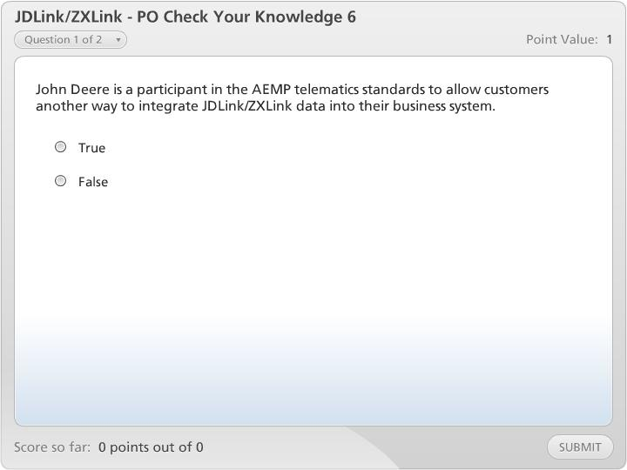
JDLink/ZXLink - PO Check Your Knowledge 6

Slide 54
Product Overview Summary
Product Overview Summary
Describe JDLink/ZXLink
Identify the various hardware and subscription levels of JDLink/ZXLink
List the features of each level of JDLink/ZXLink
Explain the In Base Strategy for JDLink and ZXLink
Describe how the JDLink/ZXLink Machine Monitoring System works
Identify the major components
List the key features on the JDLink/ZXLink Web Application
Determine the relationship between JDLink/ZXLink and Fleet Care
Recall how JDLink/ZXLink enables Service Advisor Remote
Identify the value to the customer
Identify the value to the dealer
Notes:
In the Product Overview lesson, you learned several things about the JDLink Machine Monitoring System.
Listed on your screen is what you’ve learned in this lesson.

Slide 55
Technical Overview
Technical Overview
Review the levels of JDLink/ZXLink available
Identify the various JDLink/ZXLink installation options
Develop an effective installation plan
Recall how to configure the JDLink/ZXLink terminal and verify correct operation
Identify the power states of the JDLink/ZXLink terminal
Identify how to perform diagnostics on JDLink/ZXLink systems using the web
Determine how Service Advisor can be used for diagnosing the JDLink/ZXLink system
Dealer support resources
Notes:
In the Technical Overview lesson you will learn several items that will help you install and troubleshoot the JDLink and ZXLink Machine Monitoring Systems. By the completion of this lesson, you will be able to perform the objectives listed on your screen.

Slide 56
Hardware and Subscription Levels
Express
Select
Ultimate
Notes:
JDLink and ZXLink are available in three levels; Express, Select and Ultimate. The components used for each level were introduced in the product overview, but recall that the new Modular Telematics Gateway (MTG) is being launched for the Select and Ultimate levels of service only. There is no change in the Express hardware or installation options. Express and Select are the all makes solutions offered, and Ultimate is offered in base on many John Deere and Hitachi machines.

Slide 57

JDLink/ZXLink - TO Check Your Knowledge 1

Slide 58

JDLink and ZXLink Installation Options
Factory install
In base strategy is expanding
87 total models in base by April 1st
Refer to Info To Go or Machine Configurator for latest list
Dealer install
2 types of kits:
Ultimate Capable
Designed for a machine that can accept JDLink Ultimate
Model Specific
Universal Kit
All Makes installation
Notes:
With the in-base strategy expanding starting January 31, 2011, many more models will include JDLink or ZXLink in-base with 3 years of service. This will minimize the amount of new machines requiring a field installation. Field install kits can be ordered via the Machine Configurator and will be available in two forms: Ultimate Capable and Universal kits. The key difference is the Ultimate capable kits are model specific and connect to the CAN Bus on the machine. Universal All Makes kits are only available at the Express and Select levels and can be installed on virtually any machine that has 12 or 24 Volt systems.
Any assistance required in regards to what kit to order, DMAC is always a good reference.

Slide 59

JDLink/ZXLink - TO Check Your Knowledge 2

Slide 60


Installation Planning
Installation instructions
Safety plan and considerations
Identified power source
Identified cable routing
MTG or Express Terminal mounting location
Antenna mounting location
Customer approval
Notes:
When field installing JDLink or ZXLink, you will need an effective installation plan that will include the elements listed on your screen:

Slide 61

Installation Instructions
Detailed generic or machine specific installation instructions can be downloaded from the Technical Service Information Bookstore website.
www.johndeeretechinfo.com
Use the “Installation Instructions” link to access the Installation Instructions Library
Notes:
Detailed installation instructions can be found by doing a Library Search from the Technical Service Information Bookstore website.

Slide 62

Installation Plan - Safety
Always remember to use common sense safety procedures at all time
Prior to working on the machine, disconnect the battery power
Use proper welding procedures on machines with electronic control devices
Verify with the customer that the machine is safe to operate when the installation is complete
DO NOT Drill or weld on ROPS/FOPS unless specifically instructed by John Deere or Hitachi Engineering. This could invalidate the ROPS/FOPS warranty and may require replacement at installer or dealer expense
Notes:
Before beginning an installation, always plan for the listed safety considerations.

Slide 63

MTG Key Specifications
Input Voltage
The voltage range for switched and unswitched power: 9-32VDC
Fuse recommendations
The device should be protected with a 10A fuse maximum.
Current Draw
There are three power states in the MTG. Powered On, Sleep mode and Hibernate.
The maximum current draw in each state is:
Powered On 0.3A or 300 milliamp
Sleep Mode 0.025A or 25 milliamp
Hibernate 0.001A or 1 milliamp
Notes:
Listed on your screen are some key specifications of the MTG used for Select and Ultimate subscriptions. Details of the power states will be discussed later in this program.

Slide 64

Wiring Configuration – Ultimate Capable
Chassis Ground
CAN Connections to the Machine
Ground 7.5A Fuse
Ignition Power 5A Fuse
Battery Power 10A Fuse
Optional
Notes:
Shown is the basic wiring configuration for Ultimate Capable installations for the Modular Telematics Gateway (MTG). There are four main wiring inputs to the MTG controller regardless whether it is a Select or Ultimate installation. The four main wiring inputs are a Chassis Ground, a fused ground input, a fused ignition power input and a fused battery power input. There are also CAN connections from the MTG to Vehicle on John Deere and Hitachi machines for obtaining machine information for Ultimate systems as well as machine hours from the monitor. Machine hours captured from the monitor will be the standard for Ultimate Capable machines warehoused after January 31st.
The optional Satellite module is also shown on this diagram, but recall that this will not be available until later in 2011. During the installation of the SAT module, there will be an association process between the MTG and the SAT module. Details of this process will be made available prior to the SAT introduction.

Slide 65
Wiring Configuration – Select All Makes
Chassis Ground
No CAN Connection for All Makes Kits
Ground 7.5A Fuse
Ignition Power 5A Fuse
Battery Power 10A Fuse
Optional
Notes:
For all makes installation, the major difference will be there are no CAN connections between the MTG and the vehicle. To calculate hours with no CAN Connection, the MTG has logic to notice when the voltage increases due to the alternator running in an all makes installation.

Slide 66
Universal Wiring Configurations
There are four possible power wiring configurations when doing a universal install.
No battery disconnect
Negative battery disconnect
Positive battery disconnect
Power relay disconnect
All Makes Installation Instructions will discuss all options
Notes:
The configuration of the battery disconnect will determine the wiring connections. Listed on your screen are the four possible wiring configurations. Always refer to the Installation Instructions for details of each option.

Slide 67

System Wiring Requirements
MTG and Express Terminals must be able to:
Communicate 24 hours a day and requires a constant power location that is not shut off with a disconnect or relay
Have a ground on the battery negative side of the system to use as a baseline ground that is not shut off with a disconnect or relay
Notes:
Different power installation types are necessary to meet the requirements of the JDLink terminal. These requirements are listed on your screen.

Slide 68
CAN Connection – Ultimate Capable
Locate the CAN termination node nearest to the MTG
Disconnect the CAN termination node
Connect the machine CAN connection to the JDLink/ZXLink CAN harness
Connect the CAN termination node to the JDLink/ZXLink CAN harness
Notes:
For Ultimate Capable installations, the CAN harness is connected by following the steps listed on your screen.

Slide 69

Cable Routing
Route properly to avoid excessive heat sources
Recommended to follow existing wiring
Keep wire flexing and chafing to a minimum
Protect as necessary
Power Harness may be cut shorter to facilitate better routing to termination points
Notes:
Proper cable routing is an important part of the installation process to ensure reliable communication of the terminal. Shown on your screen are some basic cable routing tips.

Slide 70
MTG Mounting
Modular Telematics Gateway:
Must be mounted to limit exposure to excessive heat and machine fluids
Can be mounted in any position
Use supplied hardware to mount unit
Notes:
Use the guidelines listed on your screen when mounting the MTG. The Installation Instruction will always be you best guide.

Slide 71

Antenna Mount
Determine antenna placement
GPS signal can pass through plastic, fiberglass and glass
Metal will obstruct GPS signals
Avoid routing cables in locations with exposure to excessive heat and physical damage.
Open view of the sky is required and antenna should be level (failure to do so could degrade GPS function.
Notes:
Antenna placement is important for optimum GPS performance. Follow the guidelines listed on your screen when mounting the antenna.

Slide 72

Customer Approval
Make sure your box mounting, antenna location and wire routing locations are acceptable to the customer
Make the installation as professional and invisible as possible to the customer
Notes:
A very important step in the installation is making sure your installation is acceptable to the customer.

Slide 73

Installation Questions
Refer to the machine specific DTAC group for installation questions on John Deere or Hitachi machines with factory installed systems.
For All Makes installation assistance, contact the Customer Contact Center (CCC).
The CCC should also be contacted for basic communication diagnostics after the installation is complete.
Notes:
If there are any component specific installation questions or technical issues with the JDLink/ZXLink system, contact the specific groups listed on your screen.

Slide 74

JDLink/ZXLink - TO Check Your Knowledge 3

Slide 75

Activation, Registration and Setup
Field Installed Express, Select or Ultimate systems
An activation and registration process is required
Express
GT Config Tool
Select and Ultimate
Some Ultimate field installations will auto register
Web or Service Advisor are used for an active registration
Notes:
Field installed systems, regardless of subscription level, require an activation and registration. Express will require the GT Config tool. Select and Ultimate field installed systems can be set up using the web or Service Advisor. We will briefly look at each option. Some Ultimate field installations will auto register. The web or Service Advisor can be used if the Ultimate system does not auto register.

Slide 76

Express Installation Configuration Tool
The GT Config Tool is software and a cable that connects the Express Terminal to a laptop
Requires serial port or serial port adapter on your laptop
Can also be used with the previous GTT hardware for diagnostics
Procedure can be found in CTM10006
Notes:
The GT Config tool is used for initial registration when installing an Express system. It can also be used for diagnostics and troubleshooting the Express terminal as well as the previous GTT hardware from Qualcomm.

Slide 77
MTG - Registration Process Ultimate Installations
Install the Ultimate kit on the machine.
Make sure the machine is in an area where there is good cell coverage
Let the machine run for 5-10 minutes after it is installed.
The terminal will auto register during this time on most Ultimate capable machines
Go to the JDLink/ZXLink web to verify that the MTG registered and the correct equipment info is displayed
If the auto registration is not successful, perform an active web or Service ADVISOR registration.
Notes:
If the MTG is being installed on a John Deere or Hitachi machine that is Ultimate capable, let the machine run for 5-10 minutes after the installation in a good cellular coverage area and the terminal will auto register. Check on the JDLink/ZXLink web application that the terminal has registered and is reporting the correct machine information. If the auto registration is not successful, an active registration will be required.

Slide 78

MTG Installation Active Registration Process
Two methods to perform the active MTG registration process
Web
No connection to the machine required
Service ADVISOR
Hardwired connection to the machine is required
Notes:
There are methods for performing an active MTG registration. Through the web and using Service ADVISOR.

Slide 79

MTG - Web Registration Process
Go to the JDLink/ZXLink web to verify the new terminal is listed
It will show as uninstalled in the Terminal Setup section
Go to StellarSupport.com
Click on “Activations”
Click “Activate” under the JDLink icon
Select “My JDLink Units”
Select the terminal to activate
Choose the “Activate New” option and click Continue
Notes:
Listed on your screen are the basic steps for performing an active registration using the web. The full process can be found in the JDLink/ZXLink Diagnosis and Tests manual (TM114519).

Slide 80

MTG - Service Advisor Registration
Notes:
The second option for registering a field installed JDLink or ZXLink system is through the use of Service ADVISOR. Details of the registration process can be found in the JDLink/ZXLink Diagnosis and Tests manual (TM114519). The summary of the process is as follows:
Connect Service ADVISOR to the MTG harness and establish a connection to the MTG.
Open the Calibrations tab in Service ADVISOR.
Expand folders to locate the MTG Modular Telematics Gateway folder and select JDL Calibrations
Enter relevant information in New Value fields.
• Equipment ID — Unique machine name so that machine can be differentiated from others.
• Engine hours — Number of hours machine has been in use.
• PIN — Unique number for machine identification. In most cases this number will be the machine VIN
• ESN — Engine Serial Number can be used for machines that do not have a standard VIN.
Move machine to an area where the antenna has a clear view of the sky or horizon and allow the engine to run for 10 minutes. This will allow time for the MTG to call in and register the new settings.

Slide 81

JDLink/ZXLink - TO Check Your Knowledge 4

Slide 82


MTG Terminal Power States
Three terminal power states
On
Terminal can respond immediately upon request
Sleeping
May take up to one hour before the MTG terminal responds
Hibernating
Terminal will not respond until the machine is turned on
Notes:
There are three different power states of the MTG terminal and the status can be found in the terminal setup page. When the terminal is on, the terminal is awake and can transmit or receive immediately upon request. The terminal is on when the machine is powered up, the engine is running and by default for 3 hours after the machine is shut off. The system will go into sleep mode after 3 hours of the key being off, but this can be modified by an account manager or administrator. Also by default, the system will go into hibernation mode after 7 days of being in sleep mode. It is important to understand how these states affect response time when a terminal is called or a Service Advisor Remote session through the MTG is not successful.

Slide 83

MTG Terminal Power States
Terminal Power Savings Settings
Can be modified by the Account Manager or Administrator in the Terminal Setup section
By default, sleep mode is a max of 7 days and then the terminal enters Hibernation Mode.
Notes:
When the engine is shut off, the terminal stays awake for a duration set by the administrator. Three hours is the recommended value. While it is awake, it can still respond instantly. After three hours, the terminal goes into “Sleep” mode. It will not respond to user message requests or “Call Now” requests while asleep. While in sleep mode, the terminal will “wake up” once an hour to check for requests. If there are any outstanding, it will transmit information at that time.

Slide 84

JDLink/ZXLink - TO Check Your Knowledge 5

Slide 85



Using the web as a Diagnostic Tool
Begin diagnostics remotely
Access to more data
Notes:
JDLink and ZXLink can also be used as a tool to help you in your job. The data available through the web application makes it a valuable resource to you for diagnostics. The advantage is that, depending on the level of the system installed, you can begin the diagnostic procedure before you leave the shop.

Slide 86
How to Access Data
Express and Select
Web access through JDLink/ZXLink web site
View all data: hours, location, geofence, curfew, maintenance
Ultimate Data
Ultimate web site access through JDLink/ZXLink web site
View CAN data including: fuel consumption, Diagnostic Trouble Codes and current use history (temperatures, utilizations, consumption rates, etc)
All data can also be downloaded at machine
Notes:
To fully utilize the JDLink or ZXLink System, you need to understand what data is collected for each subscription level. Listed on your screen are the methods to access the data and the basic information collected.

Slide 87

Data Examples
The type of data that is collected:
Diagnostic Trouble Codes
Red or Yellow monitor light events
Fuel consumption
Machine utilization
Hydraulic oil temperatures
Transmission oil temperatures
Coolant temperatures
Various machine utilization, etc
This data can be reviewed in several different formats, such as raw data, charts or graphs.
Notes:
Listed on the screen is the type of data that can be accessed through the web application. This data can be viewed in several formats, such as raw data, charts or graphs. Make sure to utilize this data when faced with a difficult diagnostic problem.

Slide 88
Diagnostics & Troubleshooting
If a terminal fails to communicate or register you should perform the following troubleshooting steps.
Harness/Fuse checks
Verify existing fuses are good
Verify power sources at each connection point
Verify harness integrity
Antenna Cellular/GPS failures
This is recognized by connecting Service Advisor and will tell you where to check for connections or tell you if you have weak signal strength
Notes:
If a terminal fails to communicate or register, perform the following troubleshooting steps listed on your screen.

Slide 89

Diagnostics & Troubleshooting
Notes:
Service Advisor can be used for obtaining diagnostic trouble codes from the MTG.

Slide 90

Diagnostics & Troubleshooting
Notes:
Service Advisor can also be used for checking the antennae status, registration status as well as voltage hibernation levels.

Slide 91

Diagnostics & Troubleshooting
Notes:
Service Advisor also contains special tests to assist with diagnostics. There is an option called “Force Call In” meaning, while connected, you can make the terminal report even though it is not scheduled.

Slide 92

JDLink/ZXLink - TO Check Your Knowledge 6

Slide 93
Support Resources
Bulletin Search on Deere Library website: www.johndeeretechinfo.com
Customer Contact Center
JDLink Machine Monitoring System information located on DealerNet – Sales – Product Information – Info To Go
DTAC – input case with machine model “JDLink”
Notes:
There are several important locations to access help information to support your customer using JDLink or ZXLink. Please refer to the information on your screen:

Slide 94
CCC’s Role with JDLink/ZXLink
Level 1 Support for JDLink/ZXLink
Web Functions
Website Functionality Assistance
Account Maintenance
Basic functionality troubleshooting
Activations & Subscriptions
Notes:
The Customer Contact Center, also known as the CCC, is used for Level 1 technical support of JDLink and ZXLink as well as web functionality questions. They also handle questions regarding activations and subscriptions.

Slide 95
DTAC’s Role with JDLink/ZXLink
Level 2/3 Support for JDLink
Advanced Technical Support
Hardware/Wiring issue Support
Installation Issues
No CAN communication
Diagnostic Information Gathering
Data Issue Support
Machine information not showing on Web
Incorrect information showing on Web
Website down issues
Notes:
DTAC is also available for supporting JDLink and ZXLink systems. There is a work group for JDLink and ZXLink specific technical questions supported out of Urbandale, IA. If you have questions in regards to installation or wiring on factory installed systems, the machine DTAC groups should be used.

Slide 96
Technical Overview Summary
Technical Overview Summary
Review the levels of JDLink/ZXLink available
Identify the various JDLink/ZXLink installation options
Develop an effective installation plan
Recall how to configure the JDLink/ZXLink terminal and verify correct operation
Identify the power states of the JDLink/ZXLink terminal
Identify how to perform diagnostics on JDLink/ZXLink systems using the web
Determine how Service Advisor can be used for diagnosing the JDLink/ZXLink system
Dealer support resources
Notes:
In the Technical Overview lesson, you learned several things about the JDLink and ZXLink Machine Monitoring System.

Slide 97
Post Assessment Information
You are about to enter the Post Assessment. After you answer a question, you will click the "submit" button. You will have ONE attempt to answer each question, you cannot back up. 80% is required to pass. You MUST click the FINISH button on the results screen for your score to be recorded in JDU.
You may take the test as many times as you need to pass, however you must exit and re-enter the course for the new score to register properly in JDU.
Please note, if you do retake the test, your score will be replaced. If you do not wish to take the assessment now, you may exit the course now. You may come back any time to complete the assessment.
Click Here to Take Test Now
Notes:
You are about to enter the Post Assessment. After you answer a question, you will click the "submit" button. You will have ONE attempt to answer each question, you cannot back up. 80% is required to pass. You MUST click the FINISH button on the results screen for your score to be recorded in JDU. You may take the test as many times as you need to pass, however you must exit and re-enter the course for the new score to register properly in JDU.
Please note, if you do retake the test, your score will be replaced. If you do not wish to take the assessment now, you may exit the course now. You may come back any time to complete the assessment.

Slide 98

JDLink/ZXLink - TO Post Assessment

Slide 99
Completed
You have completed this course.
You may close this window when your data is finished transmitting.
Please Note: If you choose to re-take the test to update your score, you must completely exit and re-enter the course for the new score to register properly in JDU.
Notes:
Please note, if you choose to re-take the test to update your score, you must completely exit and re-enter the course for the new score to register properly in JDU.
You have completed this course. Click the X in the upper right corner of this window to close it.

Slide 100

Help!
John Deere University help line – (800)752-5347 (JDIS).
Assist with technical questions about the CD-ROM or online course
Help with ordering or finding courses
Help with finding assessments
If you need assistance, from the menu bar go to
"Downloads & Support" and select
"Contact US/Feedback”.
Notes:
For technical assistance with this course, call toll free to the JDU helpdesk.

Slide 101

How Do I Navigate?
Click to Return to the Main Menu
Email Us About This Course
View and Download Attachments
Outline Allows you to quickly find topics. Click on a menu item to jump to that slide.
Thumbnails Allows you to graphically find slides.
Search Allows you to quickly find topics by searching for a word. Click on the results to view the slide with the information.
Notes Allows you to view the narration notes.
View Options Click to hide navigation pane. Click again to hide player controls and view slide only. Click again to return to standard view.
Expand Navigation items with arrows next to them will expand a section when clicked.
Slide Number
Last Slide Viewed
Go To Next Slide
Play/Pause
Volume Control
Slide Bar
(Click on bar to rewind)
View Slide Notes
Notes:
Click on the Main Menu Button to return to the main menu.

